Slide 1
ietf-ccamp-yang-otn-slicing
GitHub: https://github.com/aguoietf/ietf-ccamp-yang-otn-slicing
Document format
Propose to use Kramdown for easily tracking changes
.txt, .docx versions also uploaded

Slide 2
Issue Tracking
https://github.com/aguoietf/ietf-ccamp-yang-otn-slicing/issues

Slide 3
Proposed Call Schedule
Weekly or Bi-weekly
Candidate time slots
Doodle poll: https://doodle.com/poll/8eb8iabyhx2vewyi
Tue 10-11am EST / 10-11pm China / 4-5pm Europe
Wed 8-10am EST / 8-10pm China / 2-4pm Europe
Thu 9-10am EST/ 9-10pm China / 3-4pm Europe
Fri 8-10am EST / 8-10pm China / 2-4pm Europe

Slide 4
Functional Diagram of OTN-SC
Orchestrator/E2E SC
NSC NBI
IETF-NSC
OTN-SC NBI
OTN-SC
Reference to the other draft
MPI
PNC

Slide 5
OTN-SC Deployment Scenarios
Orchestrator/E2E SC
Orchestrator/E2E SC
Orchestrator/E2E SC
Orchestrator/E2E SC
NSC NBI
NSC NBI
NSC NBI
NSC NBI
IETF-NSC
IETF-NSC
IETF-NSC
IETF-NSC
OTN-SC NBI
OTN-SC NBI
OTN-SC NBI
OTN-SC NBI
OTN-SC
OTN-SC
OTN-SC
OTN-SC
MPI
MPI
MPI
MPI
PNC
PNC
PNC
PNC

Slide 6
Expanded View of OTN-SC
IETF-NSC
NBI
Recursive (OTN-SC),
Multi-domain recursive (MPI)
OTN-SC
NBI
NBI
Non-recursive (OTN-SC),
Multi-domain recursive (MPI)
OTN-SC
OTN-SC
MPI
MPI
Non-recursive,
Single domain
L-MDSC
PNC
MPI
MPI
PNC
PNC
Notes:
Use case 1 : realization of IETF NSC at optical layer
Use case 2 : realization of IETF NSC is to use existing OTN slices to

Slide 7
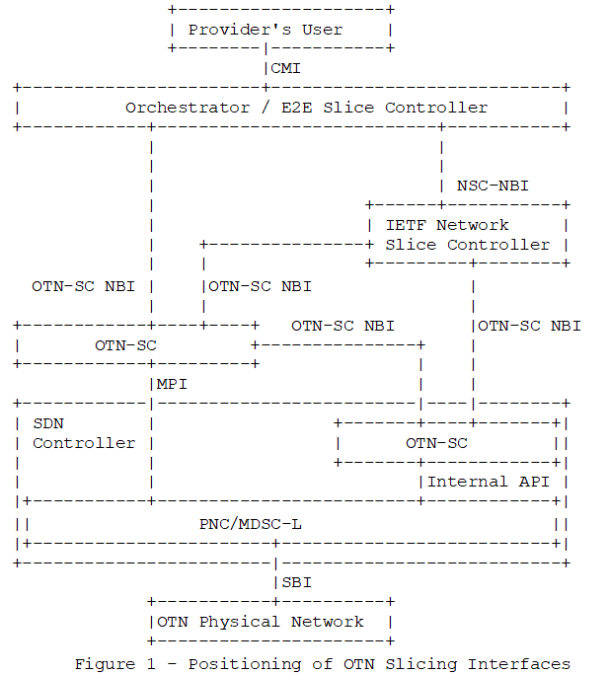
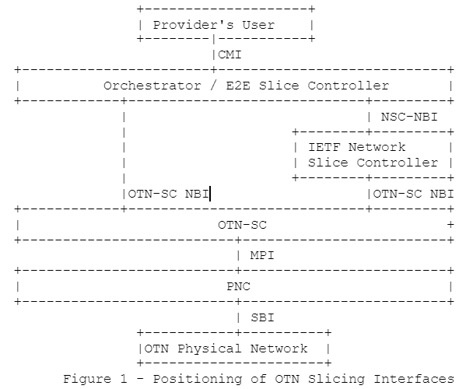
OTN-SC Figure Update

Slide 8
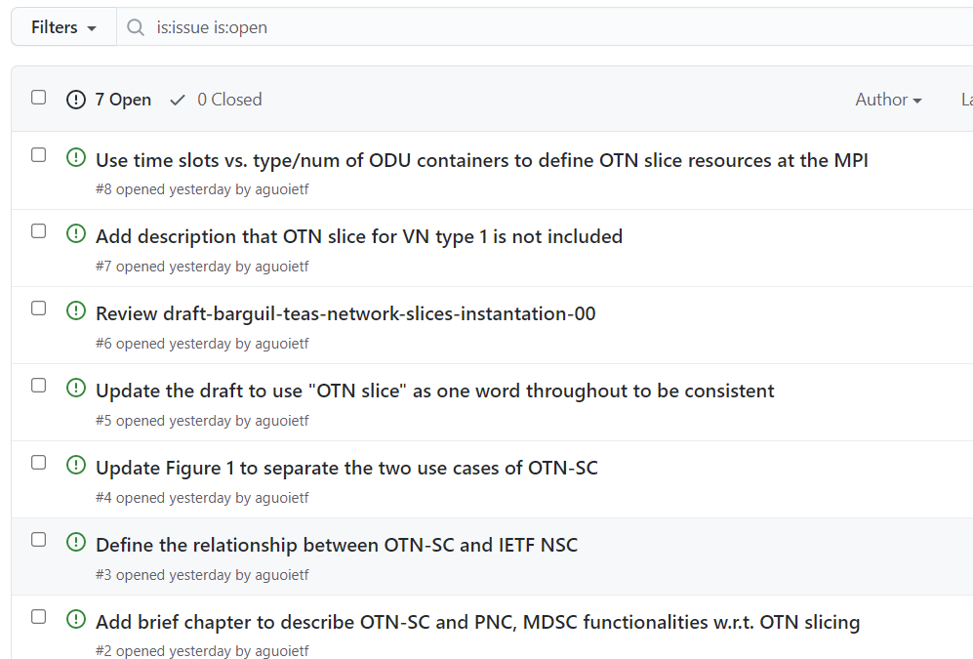
Issues - https://github.com/aguoietf/ietf-ccamp-yang-otn-slicing/issues

Slide 9
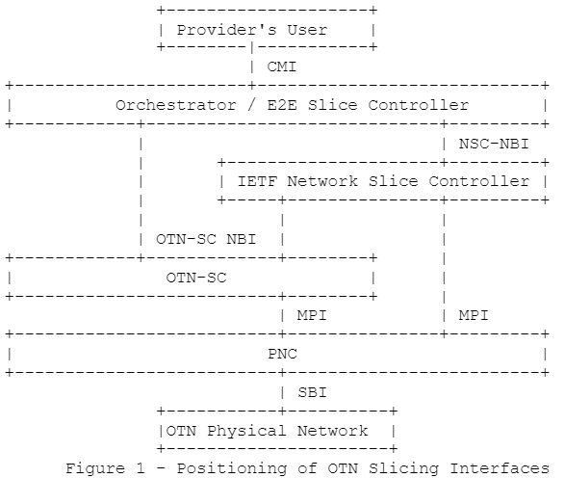
Functional Diagram of OTN-SC
Orchestrator/E2E SC
NSC NBI
IETF-NSC
OTN-SC NBI
OTN-SC
MPI
PNC
OLD
NEW

Slide 10
Scope of An OTN Slice
Single Domain
OTN Slice
Access Link
OTN Link
Access Link
CE1
X
OTN PE1
OTN PE 2
Y
Y
CE2
X
End-to-end OTN Slice
Multi Domain
OTN Slice 1
OTN Slice 2
Access Link
OTN Link
OTN Border Node
Inter-domain OTN Link
OTN Border Node
OTN Link
Access Link
CE
OTN PE
OTN PE
CE
OTN Domain 1
OTN Domain 2

Slide 11
Multi-domain OTN-SC
OTN-SC
OTN-SC
OTN-SC
MPI
MPI
OTN-SC NBI
PNC
L-MDSC
OTN-SC
OTN-SC
MPI
MPI
PNC
PNC
PNC
PNC
Single Domain
Multi Domain Option 1
Multi Domain Option 2

Slide 12
Draft-liu-teas-transport-network-slice-yang
module: ietf-network-slice
augment /nw:networks/nw:network/nw:network-types:
+--rw network-slice!
augment /nw:networks/nw:network:
+--rw network-slice
+--rw optimization-criterion? identityref
+--rw delay-tolerance? boolean
+--rw periodicity* uint64
+--rw isolation-level? identityref
augment /nw:networks/nw:network/nw:node:
+--rw network-slice
+--rw isolation-level? identityref
+--rw compute-node-id? string
+--rw storage-id? string
augment /nw:networks/nw:network/nt:link:
+--rw network-slice
+--rw delay-tolerance? boolean
+--rw periodicity* uint64
+--rw isolation-level? identityref
draft-liu-teas-transport-network-slice-yang-04 (ietf.org)

Slide 13
Draft-wd-teas-transport-slice-yang
module: ietf-network-slice
+--rw network-slices
+--rw slice-templates
| +--rw slo-template* [id]
| +--rw id string
| +--rw template-description? string
+--rw network-slice* [network-slice-id]
+--rw network-slice-id uint32
+--rw network-slice-name? string
+--rw network-slice-tag? string
+--rw network-slice-topology* identityref
+--rw network-slice-slo-group* [slo-group-name]
| +--rw slo-group-name string
| +--rw default-slo-group? boolean
| +--rw (slo-template)?
| | +--:(standard)
| | | +--rw template? -> /network-slices/slice-templates/slo-template/id
| | +--:(custom)
| | +--rw network-slice-slo-policy
| | +--rw latency
| | | +--rw one-way-latency? uint32
| | | +--rw two-way-latency? uint32
| | +--rw jitter
| | | +--rw one-way-jitter? uint32
| | | +--rw two-way-jitter? uint32
| | +--rw loss
| | | +--rw one-way-loss? decimal64
| | | +--rw two-way-loss? decimal64
| | +--rw availability-type? identityref
| | +--rw isolation-type? identityref
| | +--rw network-slice-metric-bounds
| | +--rw network-slice-metric-bound* [metric-type]
| | +--rw metric-type identityref
| | +--rw upper-bound? uint64
| +--rw network-slice-member-group* [network-slice-member-id]
| | +--rw network-slice-member-id -> /network-slices/network-slice/network-slice-member/network-slice-member-id
| +--ro slo-group-monitoring
| +--ro latency? uint32
| +--ro jitter? uint32
| +--ro loss? decimal64
+--rw status
| +--rw admin-enabled? boolean
| +--ro oper-status? operational-type
+--rw network-slice-endpoint* [endpoint-id]
| +--rw endpoint-id uint32
| +--rw endpoint-name? string
| +--rw endpoint-role* identityref
| +--rw geolocation
| | +--rw altitude? int64
| | +--rw latitude? decimal64
| | +--rw longitude? decimal64
| +--rw node-id? string
| +--rw port-id? string
| +--rw network-slice-match-criteria
| | +--rw network-slice-match-criteria* [match-type]
| | +--rw match-type identityref
| | +--rw value? string
| +--rw endpoint-ip? inet:host
| +--rw bandwidth
| | +--rw incoming-bandwidth
| | | +--rw guaranteed-bandwidth? te-types:te-bandwidth
| | +--rw outgoing-bandwidth
| | +--rw guaranteed-bandwidth? te-types:te-bandwidth
| +--rw mtu uint16
| +--rw routing
| | +--rw bgp
| | | +--rw bgp-peer-ipv4* inet:ipv4-prefix
| | | +--rw bgp-peer-ipv6* inet:ipv6-prefix
| | +--rw static
| | +--rw static-route-ipv4* inet:ipv4-prefix
| | +--rw static-route-ipv6* inet:ipv6-prefix
| +--rw status
| | +--rw admin-enabled? boolean
| | +--ro oper-status? operational-type
| +--ro endpoint-monitoring
| +--ro incoming-utilized-bandwidth? te-types:te-bandwidth
| +--ro incoming-bw-utilization decimal64
| +--ro outgoing-utilized-bandwidth? te-types:te-bandwidth
| +--ro outgoing-bw-utilization decimal64
+--rw network-slice-member* [network-slice-member-id]
+--rw network-slice-member-id uint32
+--rw src
| +--rw src-network-slice-endpoint-id? -> /network-slices/network-slice/network-slice-endpoint/endpoint-id
+--rw dest
| +--rw dest-network-slice-endpoint-id? -> /network-slices/network-slice/network-slice-endpoint/endpoint-id
+--rw monitoring-type? network-slice-monitoring-type
+--ro network-slice-member-monitoring
+--ro latency? uint32
+--ro jitter? uint32
+--ro loss? decimal64
draft-liu-teas-transport-network-slice-yang-04 (ietf.org)

Slide 14
Modeling for OTN Slices
2-in-1:
Build a topology
Single-node for connectivity-based slices
Multi-node/link topology for resource-based slices
Create connectivity on the topology
Mandatory for connectivity-based slices
Optional for resource-based slices

Slide 15
Modeling for Connectivity-based OTN Slices
Option 1: single-node topology
Endpoint list
Each endpoint has:
Endpoint id
Reference to PE LTP
(Optional) Resource id (time slot, VLAN ids etc.)
Connectivity matrix - p2p connectivity between endpoints
Committed: resource is activated
Uncommitted: resource is reserved but not activated
Default behavior of connectivity matrix
EP1
EP3
Connectivity
EP2
EP4
Node

Slide 16
Modeling for Connectivity-based OTN Slices
Option 2: edge-edge topology
Endpoint list
Each endpoint has:
Endpoint id
Reference to PE LTP
(Optional) Resource id (time slot, VLAN ids etc.)
Connectivity matrix - p2p connectivity between endpoints
Committed: resource is activated
Uncommitted: resource is reserved but not activated
Default behavior of connectivity matrix
Path associated with a p2p connection
EP1
TP1
TP3
EP3
Link1
path
EP2
TP2
TP4
EP4
Link2
Node1
Node2

Slide 17
Modeling for Resource-based OTN Slices
Full topology
Endpoint list
Each endpoint has:
Endpoint id
Reference to PE LTP
(Optional) Resource id (time slot, VLAN ids etc.)
SLOs
SLOs for network, link, node and TP
Connectivity matrix - p2p connectivity between endpoints
Committed: resource is activated
Uncommitted: resource is reserved but not activated
Default behavior of connectivity matrix
Path associated with a p2p connection
EP1
TP1
TP3
EP3
Link1
EP2
TP2
TP4
EP4
Node1
Link2
Link3
Node2
TP5
Node3
EP5

